Slide 1

PST Conference
2010
August 2009
Chris DeJager
Director, Global Business Synergy
chris.dejager@cae.com
August 2009

Slide 2


CAE presence worldwide
20 countries
90 sites
29 training centres

Slide 3
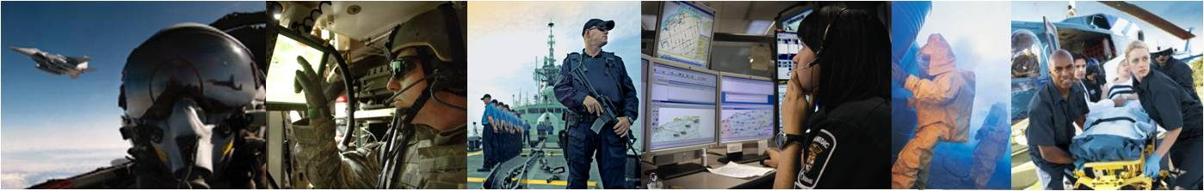
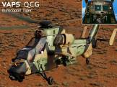
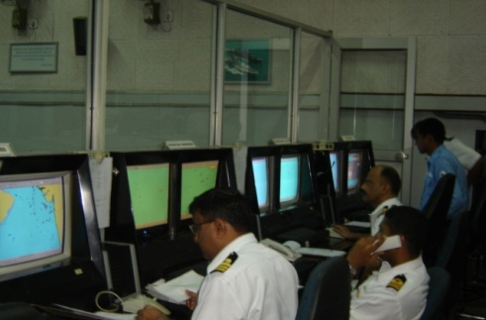
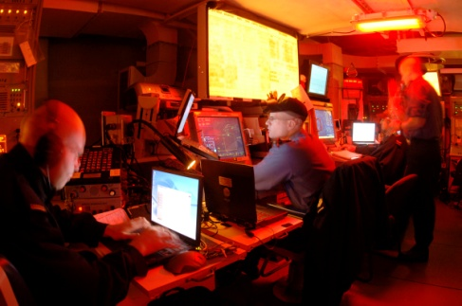
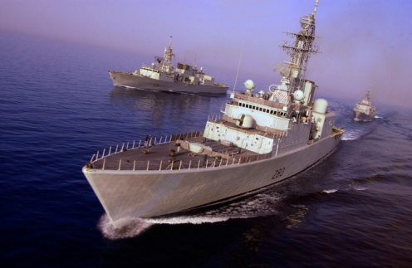
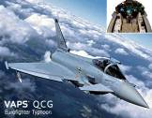
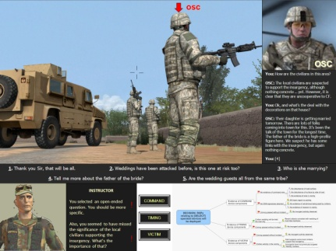
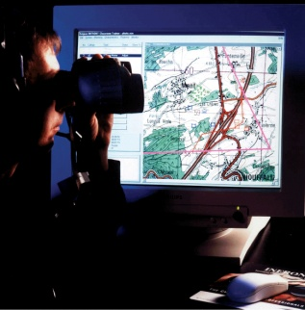
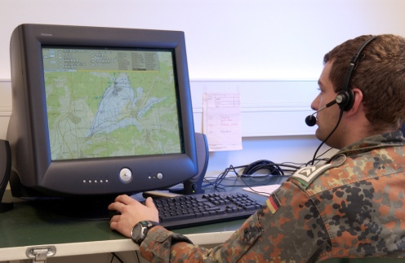
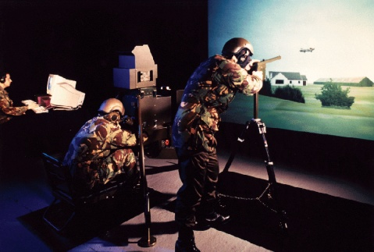
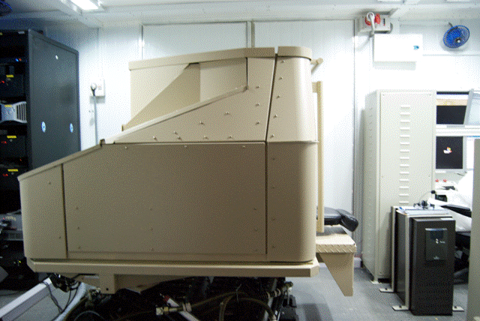
We understand Privacy, Security and Trust

Slide 4
and our DNA
It is our legacy
Operations
Analysis
Training
Modelling and Simulation

Slide 5
PST in M&S Systems to date
Largely enclosed secure networks
Participants/trainees/operators understand every action will be reviewed and analyzed
Repeated interactions to provide consistent outcomes
Technical data is secure and ITAR controlled and Controlled Goods regulated.
Few open standards between systems
Nation centric with little data sharing
No anonymity, intrusive collection of data, binary trust environment

Slide 6
PST challenges/advantages for M&S
Need to access real-time external data
Cost driver means use of lower cost technology
Human Behaviour Modelling
Participant anonymity
Speed of Simulation
Dynamic Models taking into account 1000’s of actions a second
Identify outliers
Dedicated monitoring of the system

Slide 7
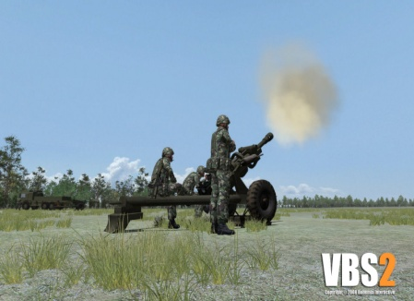
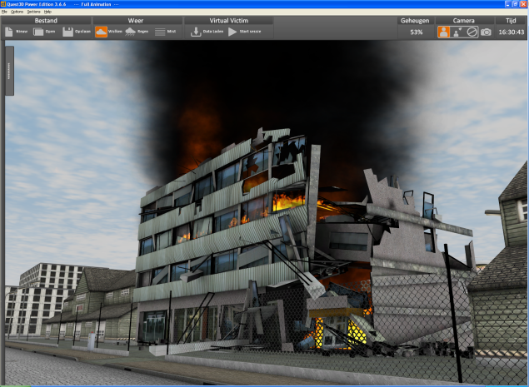
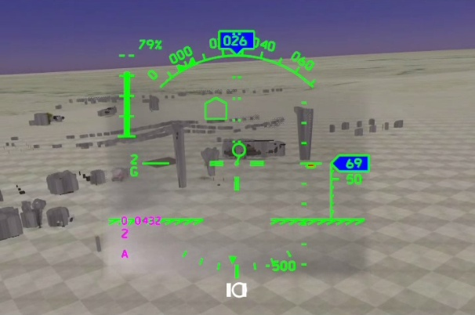
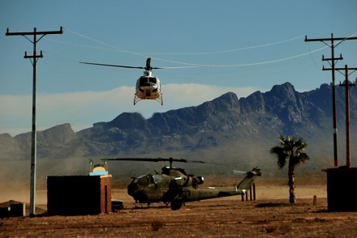
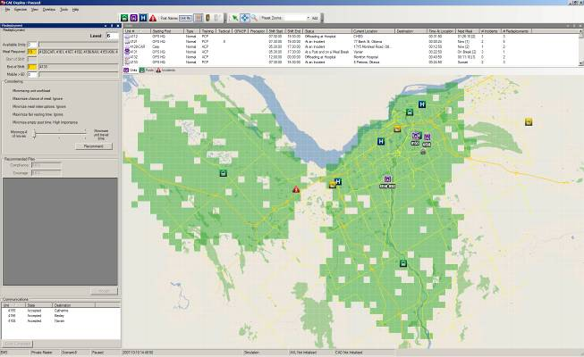
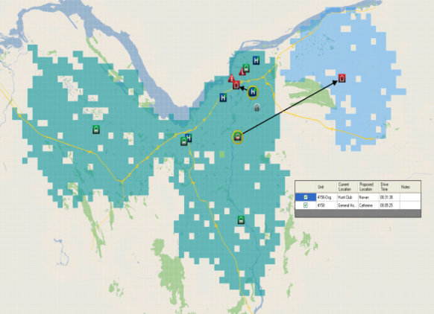
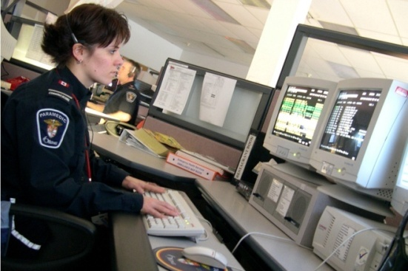
The future now
Dynamic Synthetic Environment
Leveraging real time sensor data into the models
Course of Action using faster than real-time Simulation

Slide 8

Thank you

